Slide 1
Estimating optical payload power
Methods of estimating payload power requirements (SMAD §9.5.3)
Analogy with existing systems: “Look for payloads whose performance and complexity match what we are trying to achieve and make a first estimate that our payload will have comparable characteristics.” [SMAD Table 9-13, Kremer “Observation of the Earth and Its Environment; Survey of Missions and Sensors” (1996, 2002)] → Rough, but provides bounds and a reasonable first estimate
Scale from existing systems using aperture ratio: “Most existing payloads have been carefully designed and optimized; if our system does not scale properly, it is likely that our design is not optimal.” → Moderately accurate, provides a target for what is optimal
Budget by components: “Develop a list of payload components such as detectors, optics, optical bench, and electronics. Then estimate the power of each” → Most accurate approach, but difficult to apply in early design phases

Slide 2
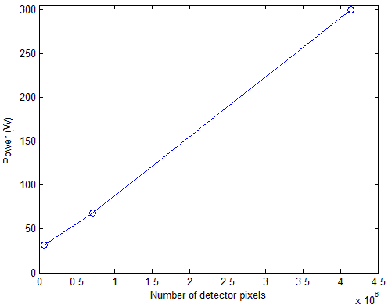
Estimating optical payload power
Approach for the CRISIS optical payload: Combination of (1) analogy and (2) scaling
Analogous systems:
Space Based Visible (SBV) Camera Spacecraft: Midcourse Space Experiment (MSX) Instrument designed by MIT Lincoln Lab 15 cm reflective telescope + thermoelectrically cooled CCD + electronics: 78 kg 420 x 1680 array (705,600 pixels) 68 W → 9.64 x 10⁻⁵ W/pixel
Airborne Digital Camera (ADC) Daedalus Enterprises, Inc. Camera optical assembly + camera head control chassis + electronics: 22 kg 2020 x 2044 array (4,128,880 pixels) ~300 W → 7.27 x 10⁻⁵ W/pixel
FireSat SMAD example Mid-range IR scanner: 28 kg 256 x 256 array (65,536 pixels) 32 W → 4.88 x 10⁻⁴ W/pixel

Slide 3
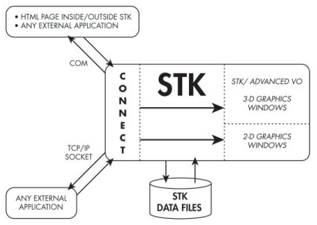
STK-MATLAB interface details
Access to STK via the Connect interface
STK provides numerous low-level ‘Connect commands’ that can control STK
Built-in MATLAB functions to create/manipulate STK objects, e.g.
stkNewObj Creates a new scenario, satellite, sensor, ground station, etc.
stkExec Allows for the execution of Connect commands in MATLAB, adding much capability
Custom-built MATLAB functions that use lower-level connect commands
stkSetSensor Sets the type and view angles of a satellite sensor Calls the STK Connect function ‘Define’ User-friendly interface
STK help manual

Slide 4
Automated coverage calculation
Primary Objectives:

Slide 5

Updated modeling flow
Previous model
Updated model
Orbit module ‘downstream’ of optics and communications modules
STK allows for the computation of performance figures (e.g. coverage, revisit time, etc.) so logically it should go near the end.
Optics and comm provide sensor and antenna specifications to STK
Power module takes power estimates from the subsystems
Upcoming week: run full simulations with the updated model
orbit.m
optics.m
adcs.m
comm.m
Sensor properties
optics.m
adcs.m
comm.m
orbit.m
power.m
Antenna & GS properties

